Slide 1
GLOBAL LEADING ONE-STOP INTEGRATED MOLDING SOLUTION SERVICE PROVIDER

Slide 2
CONTENTS
1
2
3
PROCESSING CAPABILITY OF MOLD CAVITIES AND COMPONENTS
ABOUT MOLDBAO
CONTACT US
Notes:
b8f4bec0-537d-4ce4-8021-55dd2829ed63.source.default.zh-Hans

Slide 3
1. COMPANY PROFILE

Slide 4
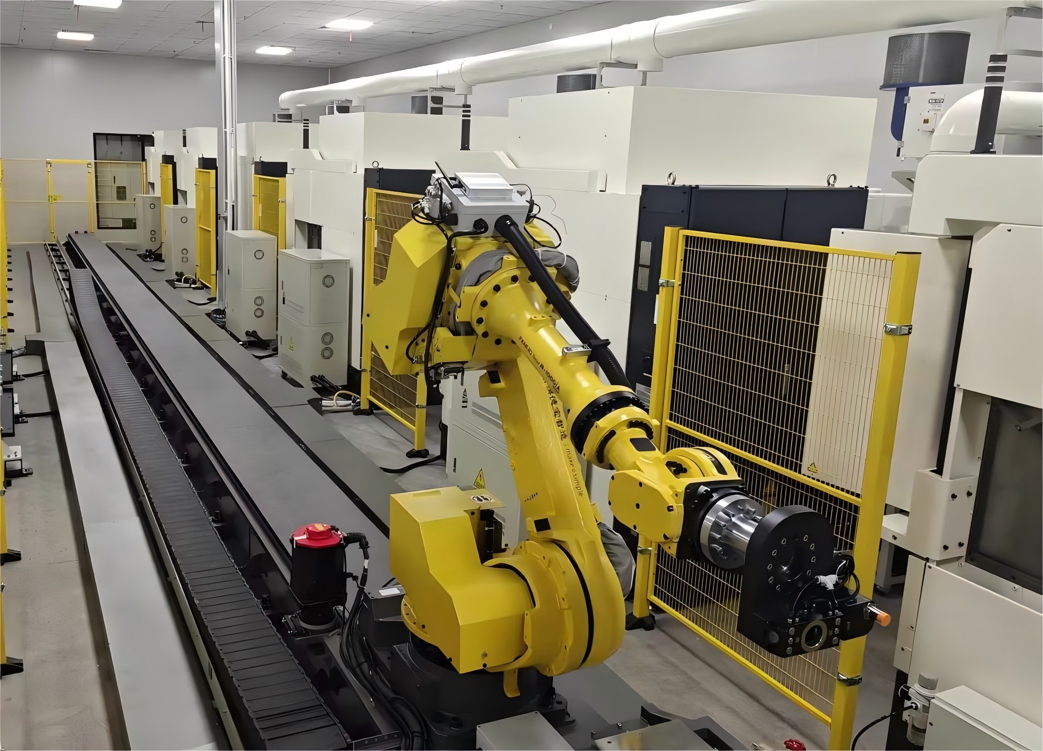
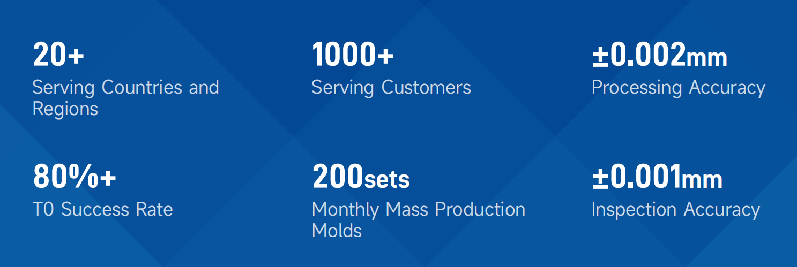
COMPANY PROFILE
Dongguan Moldcloud Intelligent Technology Co., Ltd. focuses on precision mold research and development, manufacturing,precision parts production, and product injection molding in the fields of medical equipments, consumer electronics, and automotive industries, etc. We provide one-stop integrated molding solutions for global buyers including product design, sampling(3D printing), mold design, mold manufactur_x0002_ing and max production of injection parts.
Notes:
78ed176c-8dad-4dcb-87b4-5aaf37546553.source.default.zh-Hans

Slide 5
2. PROCESSING CAPABILITY OF MOLD CAVITIES AND COMPONENTS

Slide 6
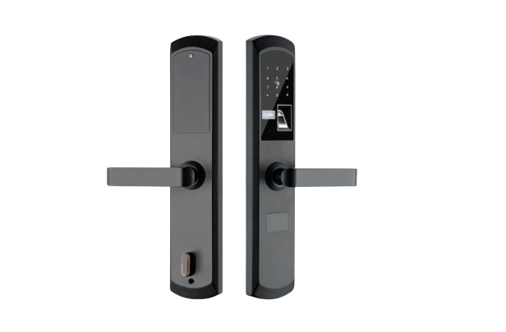
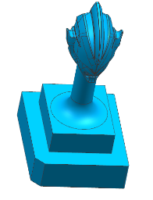
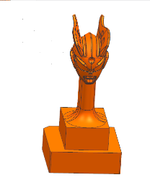
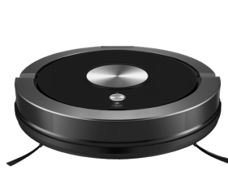
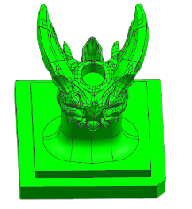
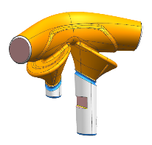
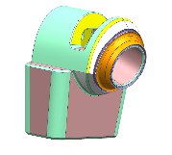
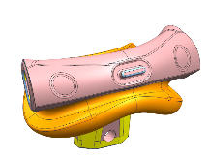
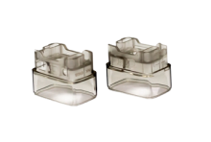
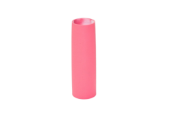
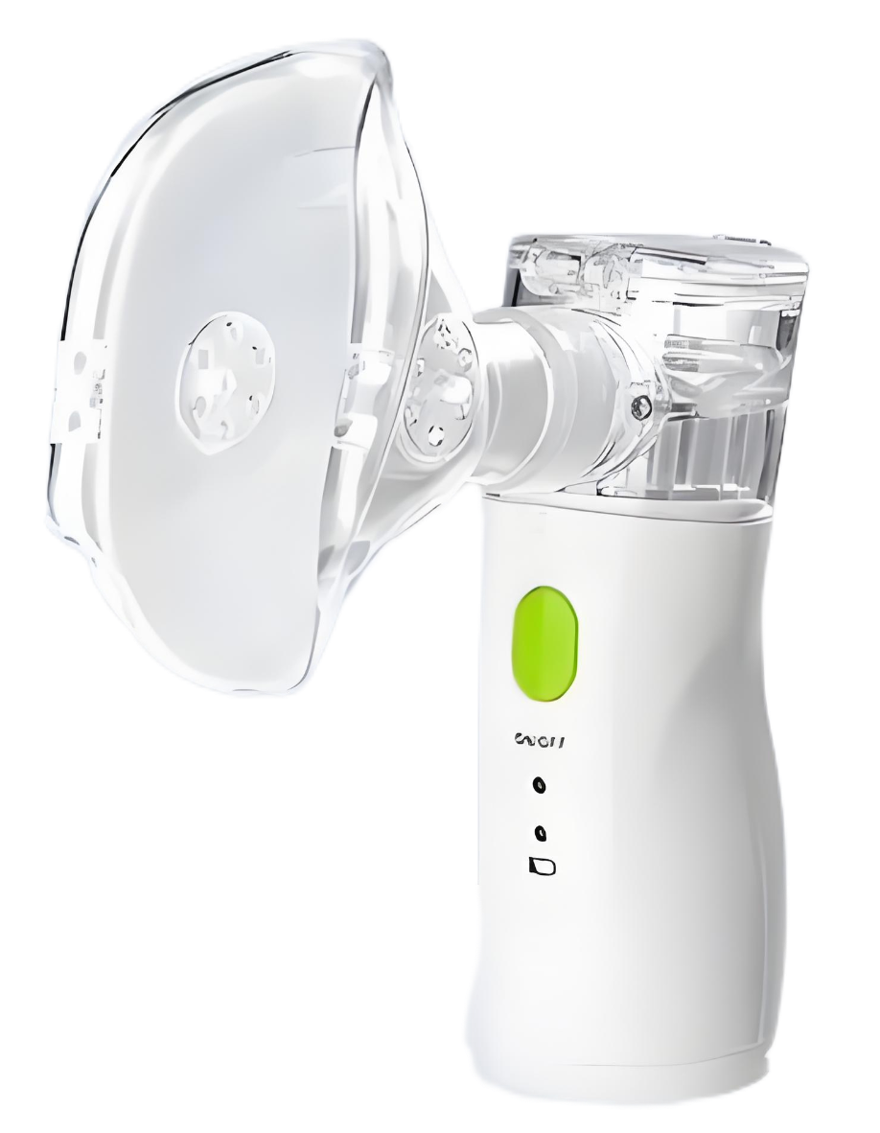
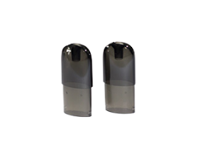
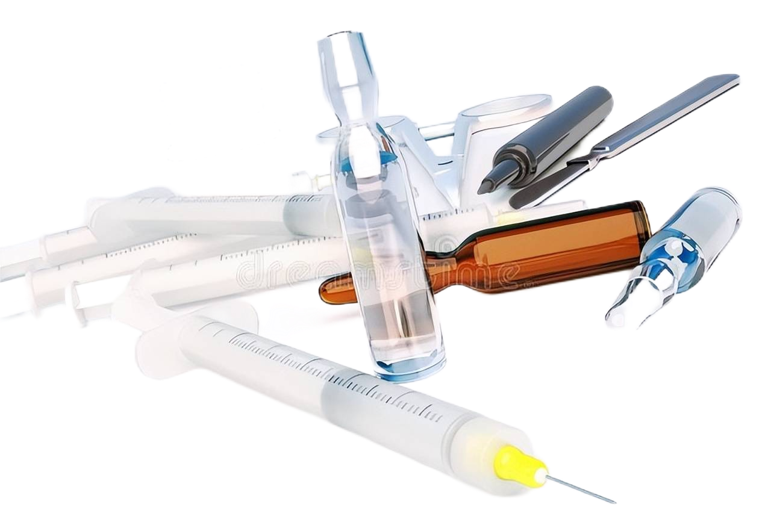
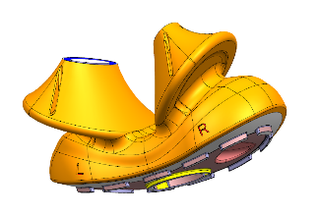
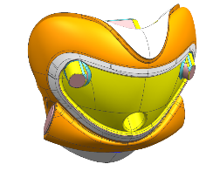
Products We Made
Consumer Electronics
Smart Home Appliances
Electronic Cigarettes
Medical Devices
Five-axis Precision Mold Parts

Slide 7
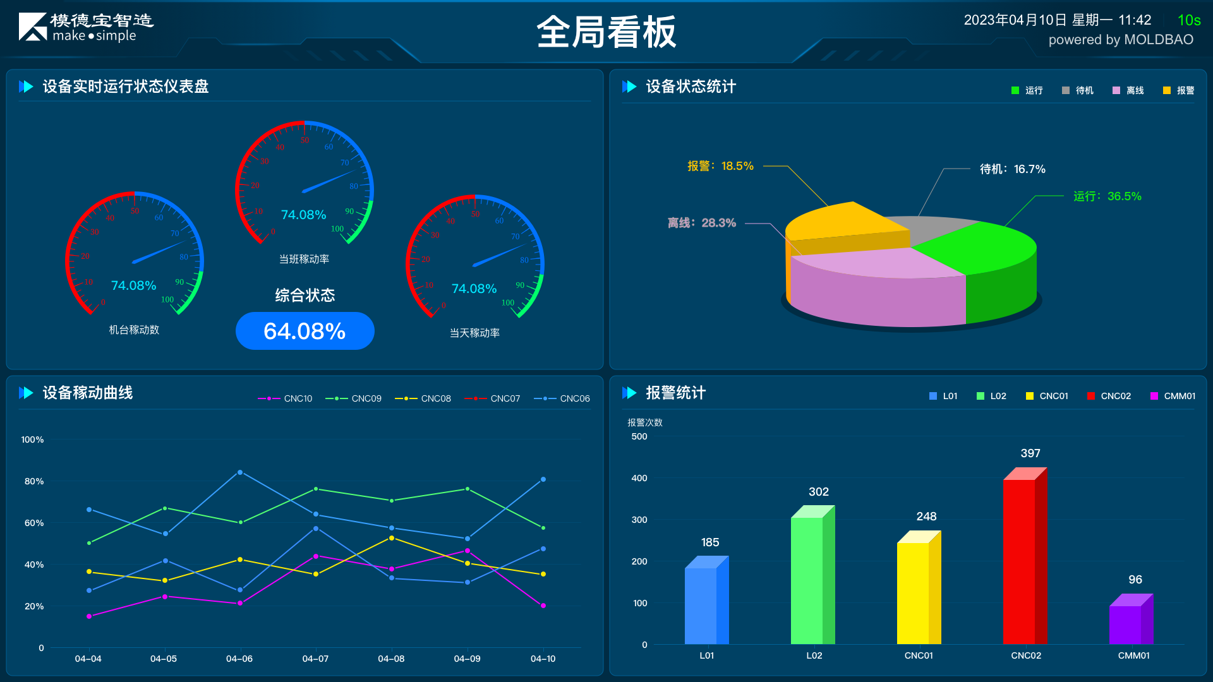
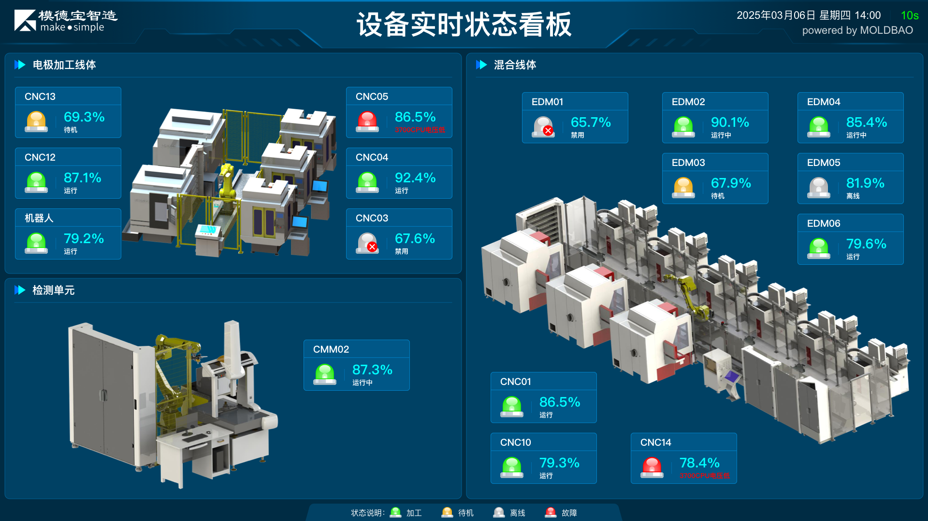
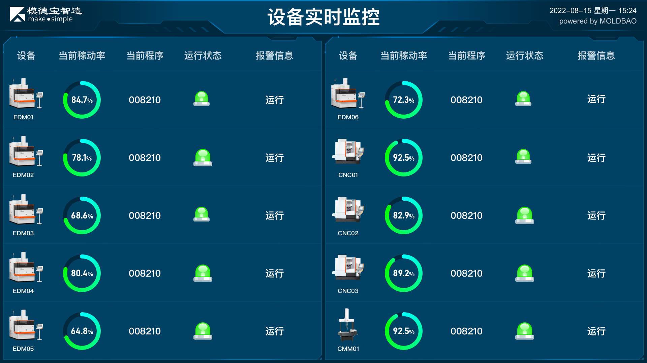
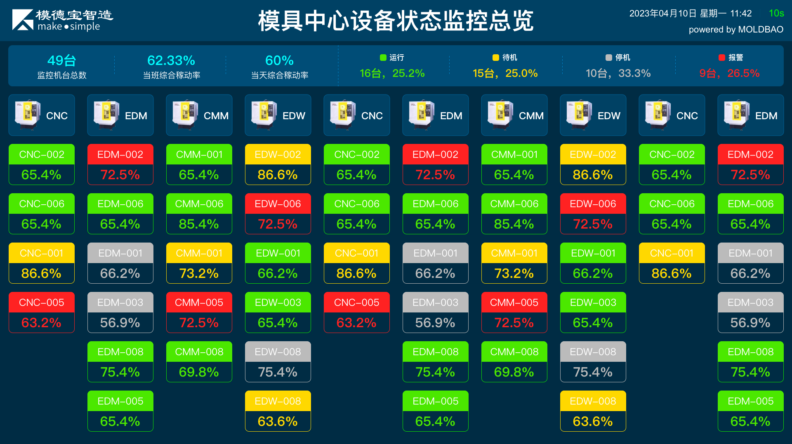
Intelligent Management — MES & SaaS

Slide 8
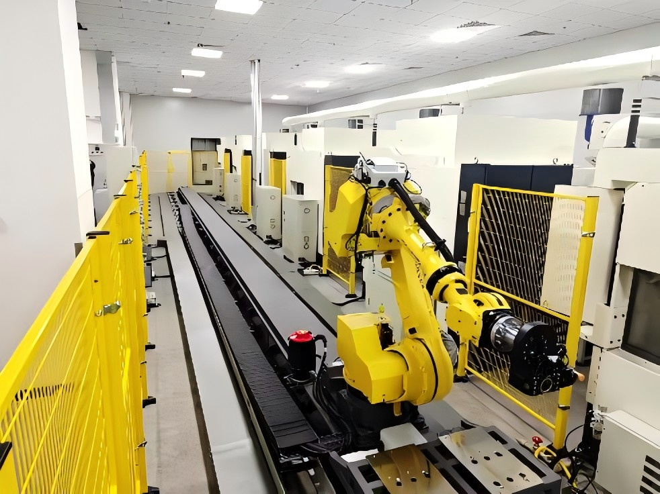
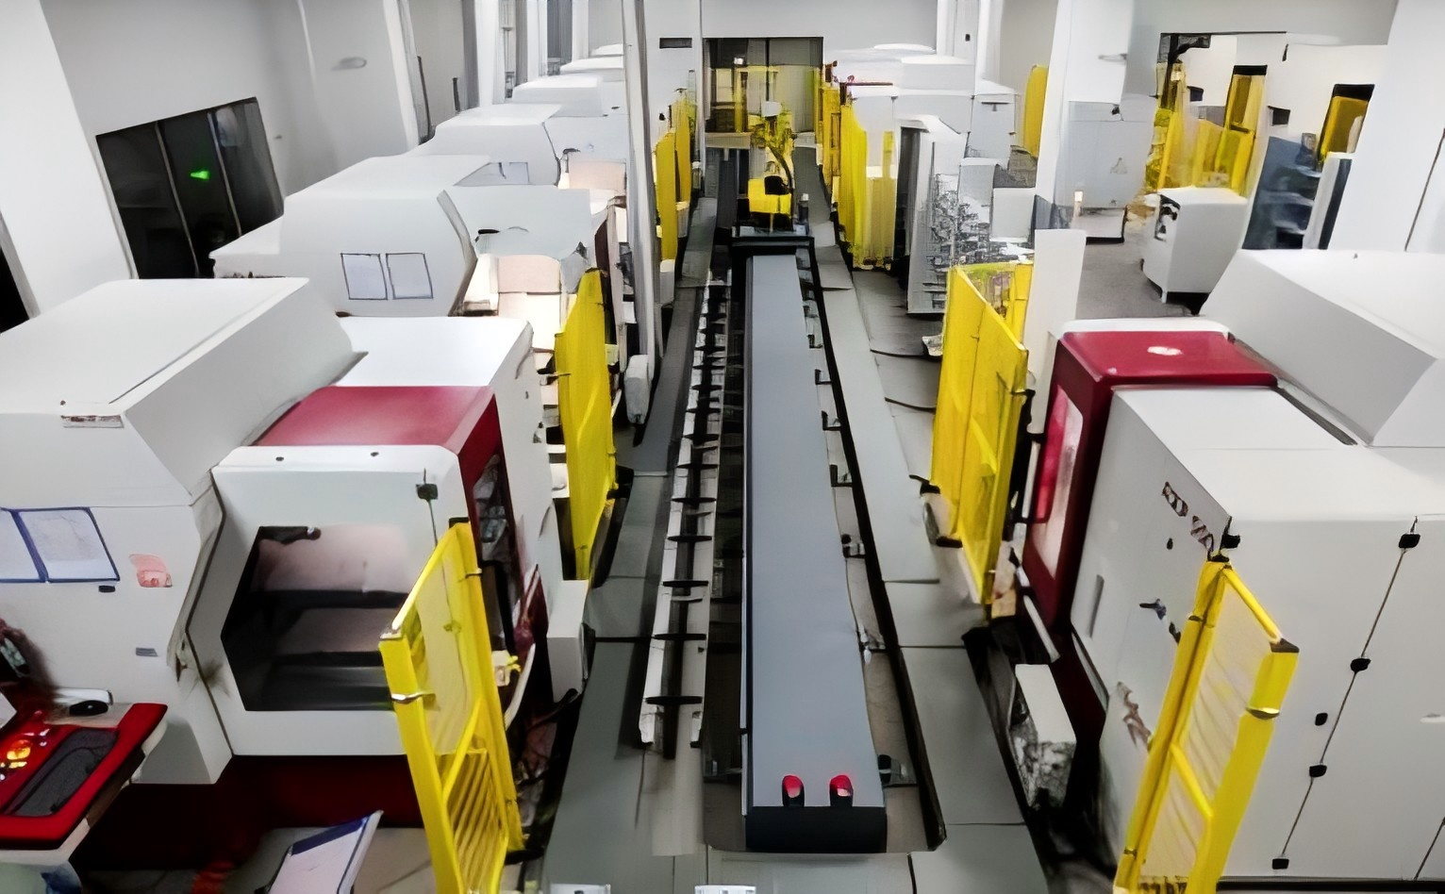
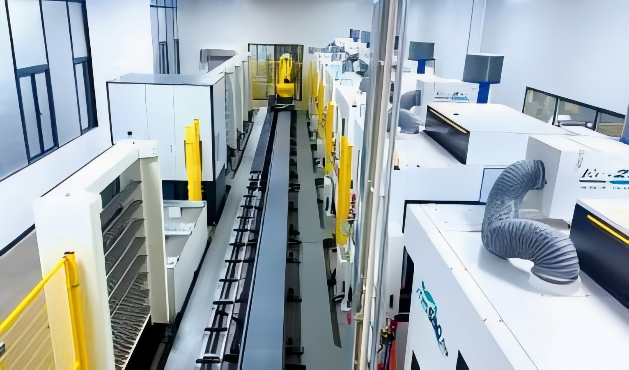
CNC Automated Machining Center
MAKINO CNC Automated
Processing Production Line
Röders CNC Automated
Processing Production Line
jiatie CNC Automated
Processing Production Line

Slide 9
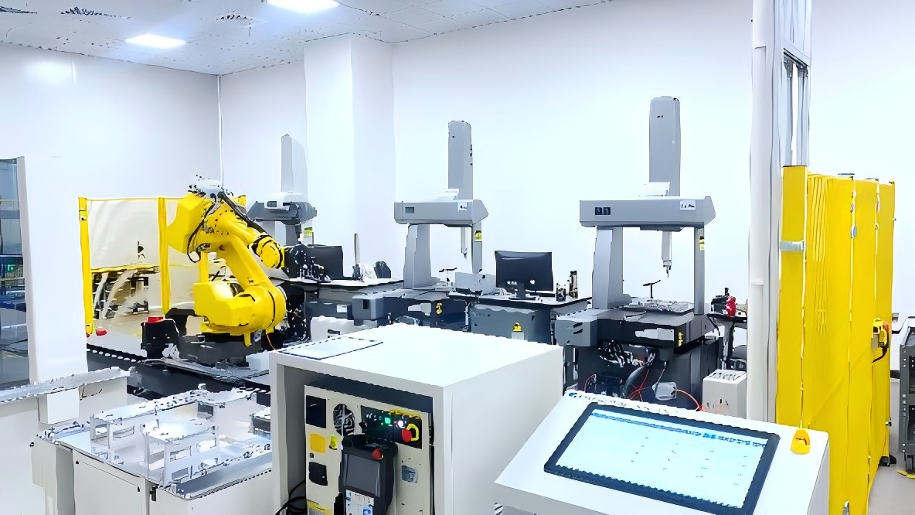
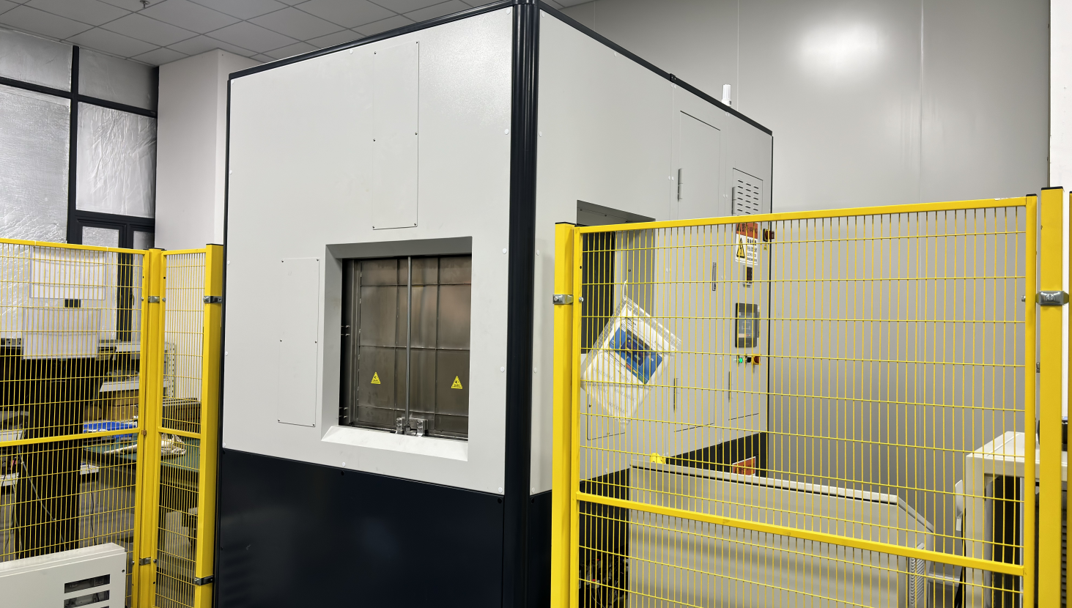
CMM Digital Testing Center
Cleaning Machine
Hexconn CMM Automated Testing Line
Cleaning Machine

Slide 10
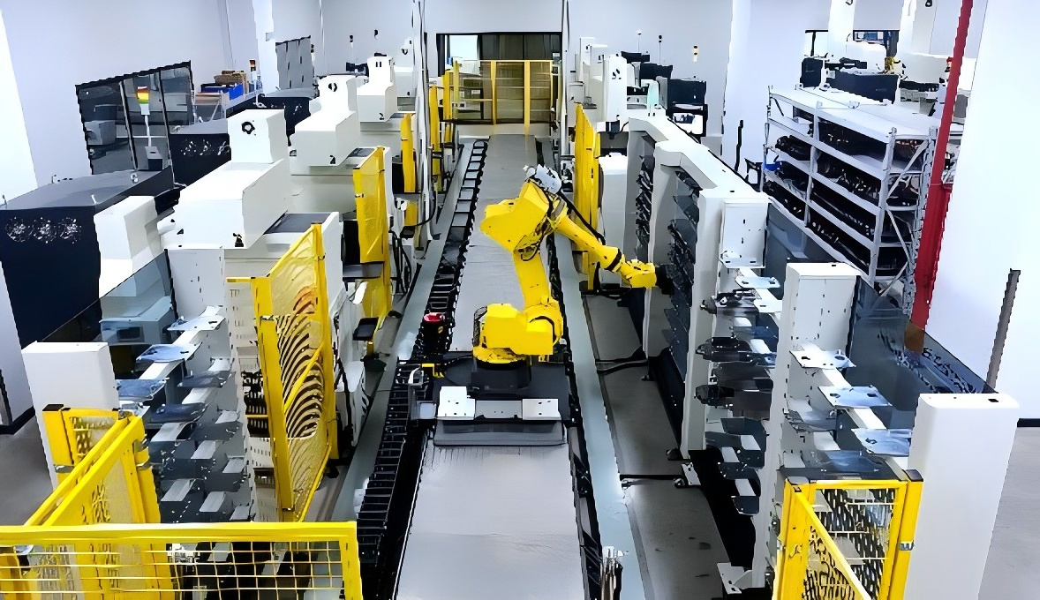
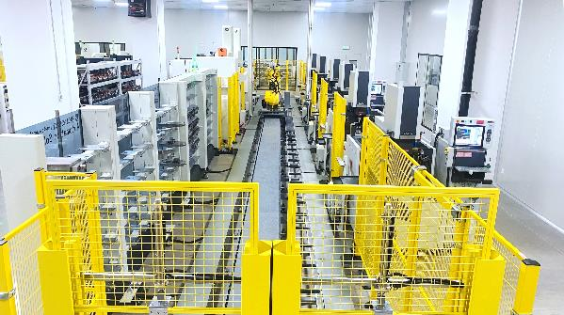
EDM Automated Machining Center
MAKINO EDM Automated Processing
Production Line
(Mitsubishi, Makino, GF) Hybrid EDM
Automated Processing Production Line
Capable of R&D、manufacturing one-stop solution.
Having a mold design team with over 100 experienced professionals supported by specialized mold flow analysis software.
Fully automated flexible mold parts production line with low labor costs.
Capable of producing high-difficulty and complex 5-axis parts.
Efficient, cost-effective, and on-time delivery.

Slide 11
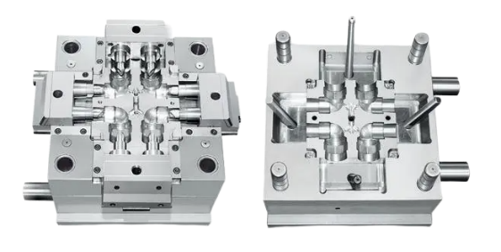
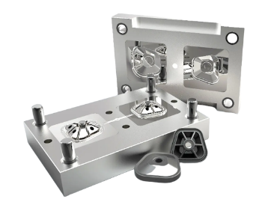
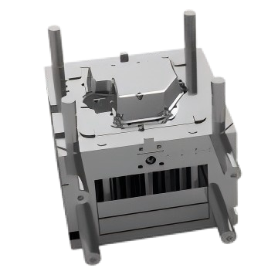
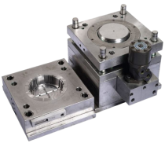
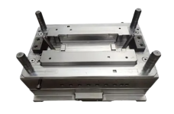
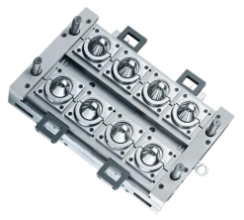
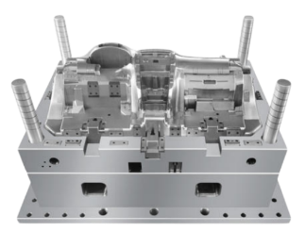
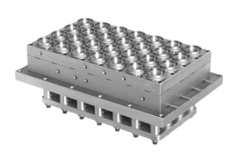
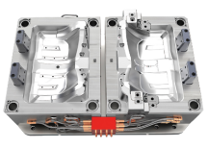
Precision Mold
Consumer Electronics
Medical Devices
Household Appliance
Automotive Parts
Food Packaging

Slide 12
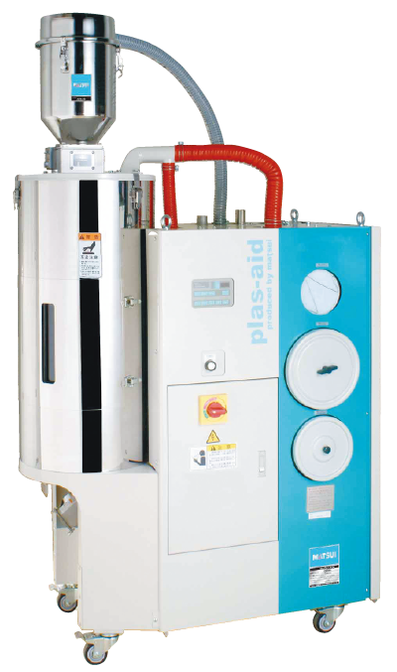
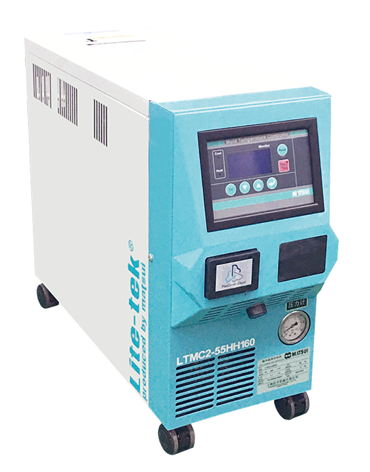
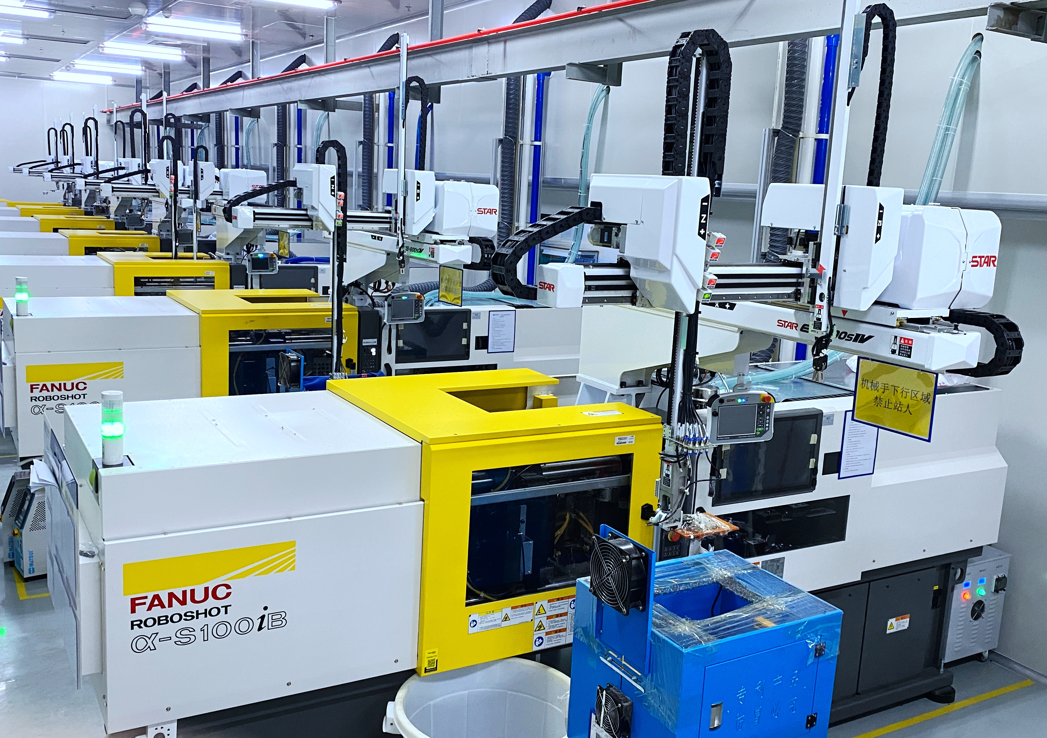
INJECTION MOLDING CAPABILITY
100000 Level Dust-free Purification Injection Molding Workshop
FANUC Electric High-speed
Injection Molding Machine
Matsui Mold
Temperature Machine
Matsui Drying Machine
FRIGEL fully-enclosed water circulation system ensures a stable production.
MATSUI mold temerature machine ensures stable production by controlling the temperature within ±0.25°C.
MATSUI drying machine ensures stable demunidification effect of materials and stable quality of each production.

Slide 13
3. CONTACT US

Slide 14
CONTACT US
+86 186 8878 5646
freeman.zhang@moldbao.com
www.facebook.com/moldcloud
Room 201, Room 101, Building 12, No. 2 Xingye Road,
Songshanhu Park, Dongguan City, Guangdong Province,China

Slide 15
THANK YOU!

